Slide 1
budget basics training
Office of Budget and Planning
Notes:
Irene - Welcome

Slide 2
AGENDA
OBP Mission and Purpose
Best Practices
Reports
Notes:
Irene

Slide 3
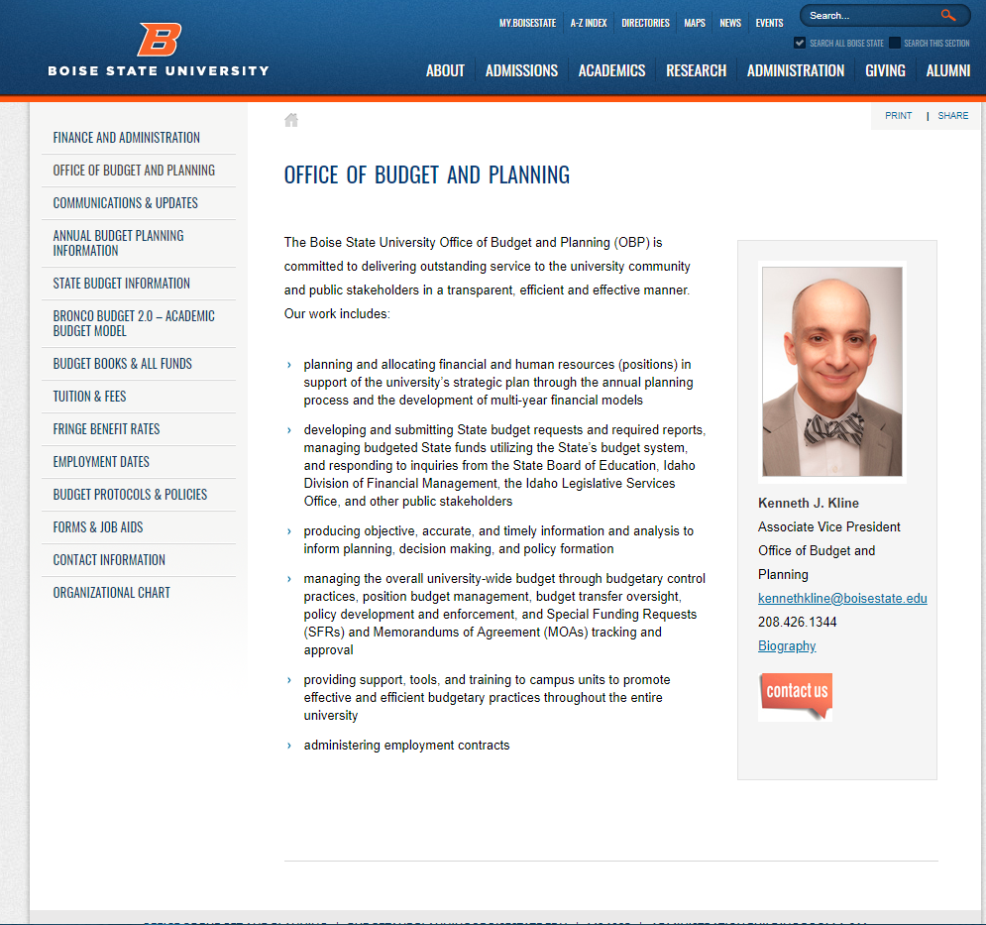
Office of Budget & Planning Website
Notes:
Irene
Find our webpage in the A-Z Index – Search: Budget Office or at vpfa.boisestate.edu/budget-and-planning
Communications & Updates- Request to be on the Google Group [BSU_Budget].
Budget Books
Fringe Benefit Rates
Employment Dates
Budget Protocols & Policies (Budget Transfers matrices, Budget Deficit Resolution, Guidelines for Appropriated Position Funding Regular Units)
BB 2.0
Forms & Job Aids – SFR, MOA, Budget Transfer template- job aids
Contact Information – meet your budget team, areas of responsibility

Slide 4
BEST PRACTICES
YEARLY OVERVIEW
A SNAPSHOT OF THE YEAR
Notes:
Gay – welcome to best practices! This part of the presentation will be an overview of things you will need to know throughout the year, which includes some deadlines and how-to’s. We will also have a desk manual available on our website toward the end of December. Thank you to Kay Trotter for updating this document. It includes a lot of detail that will be helpful for you at your desks.

Slide 5
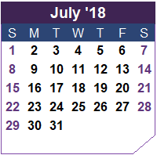
New Fiscal Year Begins.
What happens now?
Administrative Accounting is working to close the month of June, then close the fiscal year.
The new year (FY20) Budgets are loaded to OFC as of July 1:
Appropriated funds (1XXX) from State of Idaho Appropriations which includes student tuition and taxpayer money
Local funds (3XXX) from revenue or fund balance transfers
Grants (4XXX) are managed by the Office of Sponsored Projects at Boise State and typically run on grant dates not fiscal year
Auxiliary (8XXX) self-support entities. If you are working for an auxiliary, you will need to seek more advanced budget training
Notes:
Gay
So, let’s get started. The fiscal year which runs from July 1 to June 30th begins and budgets are loaded into OFC.
Here’s where your budget comes from:
Appropriated – State of Idaho appropriations
Local – Revenue or fund balance transfers from another local fund source
Grants – are managed by the Office of Sponsored Projects and are typically from grants from Federal or State funds but may be from other sources as well.
Auxiliary – are self support entities that can use either auxiliary funds or local funds from revenue.

Slide 6
Funding Sources for Budgets
 | Appropriated Budgets |  | Restricted Grants and Contracts | Local & Auxiliary Budgets
Where does the money come from? | Distributed Tuition and Fee Revenues | General Fund | Grant and Contract Revenue | All other sources
How does Boise State decide the Budget for each college or department? | Bronco Budget 2.0 (academic) Online Programs MOA Leadership Decision | Leadership Decision | Through the Office of Sponsored Programs | Depends on the funds
Notes:
Gay
This table shows you how Boise State gets different types of funding and from a very high level and who makes funding decisions.

Slide 7
July 1st your bucket is filled with appropriated base (permanent) funds:
410000 | Regular Salaries | $50,000.00
411000 | Irregular Salaries | $20,000.00
412000 | Student Salaries | $11,000.00
420000 | Fringe Benefits | $22,100.00
500000 | Other Expense (OE) | $5,000.00
600000 | Capital Outlay (CO) | $0.00
Notes:
Gay
This is a sample of what your appropriated budget might look like with budgeted roll up accounts.
Explain the rollup categories.

Slide 8
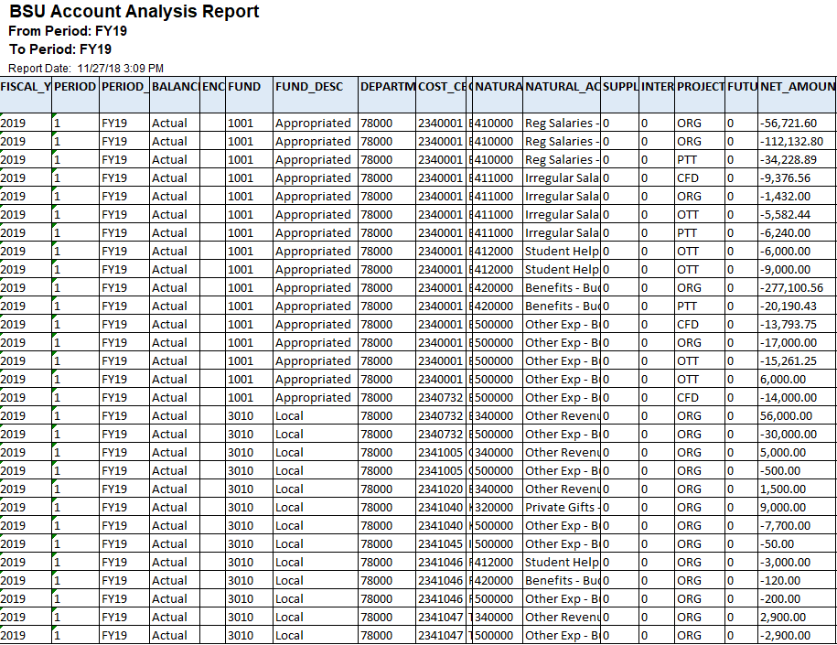
So my budget is now in OFC. What cost centers am I responsible for?
If you run a budget account analysis report with just your department number, you are able to see all of the cost centers with a budget that are associated with that department number.
Notes:
Gay
You can run a budget account analysis report (reports will be shown later) and it will help you identify all the cost centers associated with your department number. So, just a refresher, OFC accounts are fund, department, and cost center which is sometimes referred to as FDCC. The coding identifies where the funds came from. There have been both permanent PTT and one time budget transfers OTT processed to move budget in this department. The ORG is the original base budget load. CFD is carryforward and we will explain carryforward funds next.

Slide 9
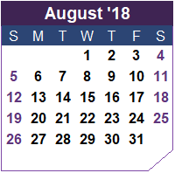
What happens in August?
Posting Carryforward Balances
Typically Appropriated Carryforward is posted the first week of August with a journal date of July 1.
Local fund balances are moved forward from the previous year by Administrative Accounting prior to the end of August.
Grants are managed by the Office of Sponsored Projects (OSP).
You will need to monitor your budgets and make sure your balances are what you think they should be. If they aren’t, you need to contact your Business Manager and/or run reports to check for budget transfers or other transactions.
Notes:
Gay
Moving on to August – this is the month that carryforward funds are posted. They are posted with a journal date of July 1st, but done in August because we need to wait for year end to close before the carryforward load. Your balances at the end of June will be what gets carried forward as one time funds into the next fiscal year. There may be exceptions, depending on the type of funds and what department you are in.

Slide 10
Any budget you have left at the end of June will be your one time carryforward amounts that are posted in August. Regular salary and fringe do not stay in your account.
410000 | Regular Salaries | $0.00
411000 | Irregular Salaries | $20,000.00
412000 | Student Salaries | $6,000.00
420000 | Fringe Benefits | $0.00
500000 | Other Expense (OE) | $550.00
600000 | Capital Outlay (CO) | $0.00
Notes:
Gay
Typically, Regular Salaries and Fringe are not carried forward into an FDCC, so after you have spent budget throughout the year, your June 30th balances without regular salary and fringe will be carried forward as one time funds into the next fiscal year.

Slide 11
How can I identify what was carried forward in OFC?
Your budget account analysis report will show you what has been loaded as carryforward with a “CFD”
Notes:
Gay
You can identify what was carried forward by looking for the CFD’s on your Account Analysis Report.

Slide 12
+
Your carryforward funds from June 30th will be added to your base funding in OFC so any balances showing on the OFC dashboard include both your original base (permanent) budget, plus your carryforward.
A more detailed explanation of one time and base funding is available in the Budget Desk Manual on our website at: https://vpfa.boisestate.edu/budget-and-planning/
Notes:
Gay
After carryforwards are posted, your base budget and carryforward budget are combined in your OFC balances. There is a more detailed explanation of this in the Desk Manual that will be on our website soon.

Slide 13
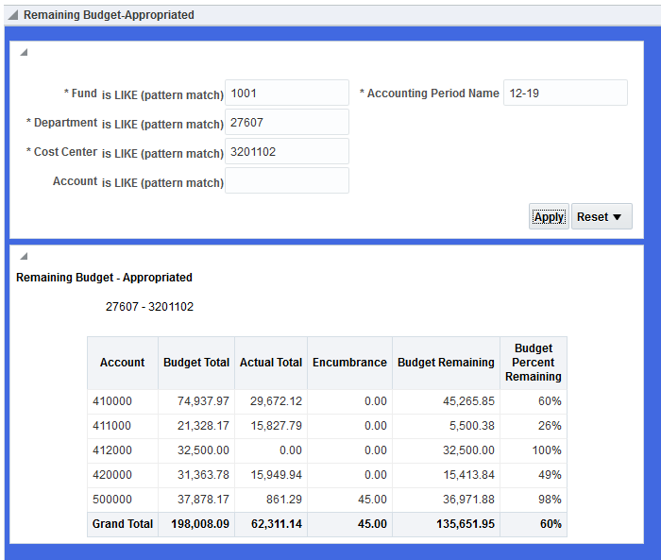
So, here’s my dashboard… now what?
Appropriated side
Local side
Notes:
Gay
When you run your dashboard report for appropriated as shown here, you will be able to see your balances in all budget categories. These balances include all base budget and one time budget in your totals.
Account is the budget roll up category
Budget Total is your base and carryforward, plus or minus any budget transfers posted
Actual Total is the budget you have spent
Encumbrance is budget being held for a specific purchase
Budget Remaining is your available budget to spend.
This is just a quick way to see how much money is in your FDCC. It may not be exact due to timing and posting of transactions, but it a quick and easy way to get a snapshot view.

Slide 14
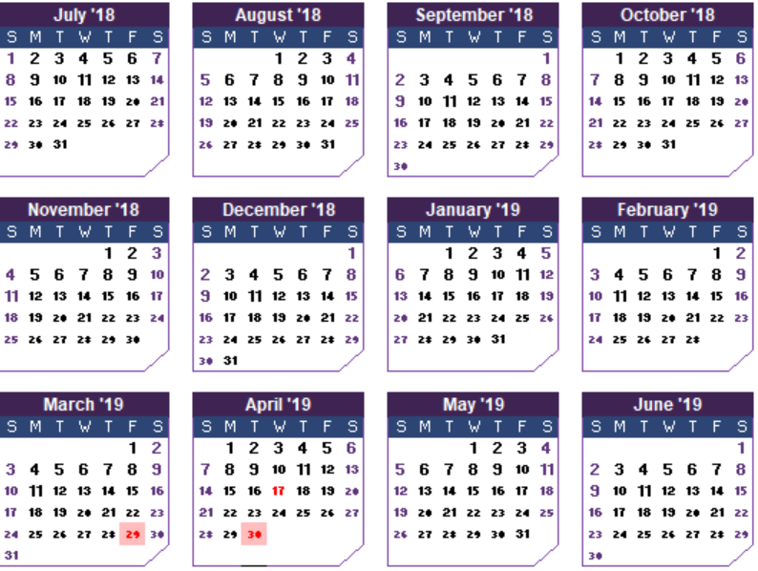
Tracking Your Budgets
Throughout the fiscal year, a review of department budgets should be conducted. We recommend this be done at least once a month.
In order to review your budgets, you can either run reports or contact your Business Manager who receives a copy of your department’s monthly OFC report.
Appropriated fund deficits need to be cleared as quickly as possible according to Budget Deficit Resolution Policy # 6330.
Uh oh! I overspent…how do I clear a deficit???
Notes:
Gay
If you are responsible for budgets, it is up to you to track your budgets throughout the year so you know the status.
Your Business Manager receives a monthly report from our office that shows current information through month end. These are sent out after month end close.
You can also run reports in OFC to check your FDCCs anytime. It is your responsibility to ensure that you don’t go into deficit. Appropriated deficits need to be cleared as quickly as possible according to policy. You can find all Boise State policies at https://policy.boisestate.edu/

Slide 15
How to Clear Deficits
Appropriated Fund Deficit
Submit a One-time budget transfer if this is only for the current fiscal year
Submit a Permanent budget transfer if base funding is needed on a permanent basis
Appropriated Fund Deficit
Submit a One-time budget transfer if this is only for the current fiscal year
Submit a Permanent budget transfer if base funding is needed on a permanent basis
Submit a correcting Journal Entry to Administrative Accounting if the deficit was caused by something incorrectly expensed to an appropriated fund or FDCC
Local Fund Balance Deficit
Submit a journal entry through Administrative Accounting for a fund balance transfer from another local fund source
Submit a correcting Journal Entry to Administrative Accounting if the deficit was caused by something incorrectly expensed to an appropriated fund or FDCC
Notes:
Gay
The budget office sends deficit notices by email to business managers each month. Your business manager will let you know if you need to do a budget transfer or do more research to determine where the deficit came from. A budget transfer or journal entry would be needed to clear the deficit depending on your specific situation.

Slide 16
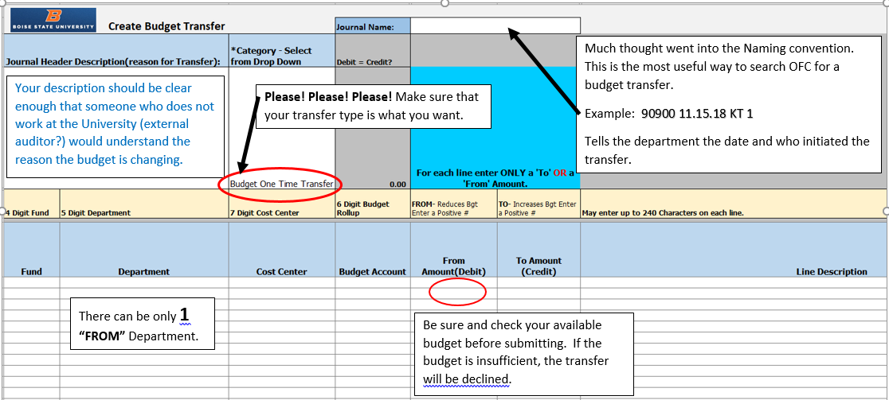
Budget Transfers
A more detailed explanation of how to do budget transfers is available in the Budget Desk Manual on our website at: https://vpfa.boisestate.edu/budget-and-planning/
Notes:
Gay
Budget transfers have specific naming conventions that need to be used for the journal name. Be sure to check the type of transfer (one time or permanent) Make sure all of your descriptions are clear and understandable. You can only transfer “from” one department, but you can transfer “to” many. Check your available balance on the dashboard before you submit your budget transfer to make sure you have funds available to transfer.
The budget transfer template and instructions are available on our website.

Slide 17
Budget and Personnel Actions
The Office of Budget and Planning works closely with Human Resources when the employee action requires new budget or a change in the existing budget.
For this reason it is important the any budget information provided on Hiring/Personnel forms contain concise and specific information and regarding position budget.
The following screens contain some basic information and guidelines.
Notes:
Kay
OBP has been tasked with ensuring there is available on-going resources to cover salaries for our most important resource. Personnel!

Slide 18
Position Budgeting
Budget Requirements
The Three Parts of Positions
Need to identify continuous funding stream to cover salaries such as:
Appropriated Base Budget
Local with a steady source of revenue
Local Fund Balance Transfer (Should identify the cost center with revenue and where revenue is obtained.)
Grant Funding (Where will base funding be provided after the grant ends?)
Position
Job Description, Title, Classification, Salary Range
Person
Individual performing the duties and receiving compensation
Budget
Where the dollars come from to pay the person
Notes:
Kay
Start with Where the Budget (dollars) will come from?
Department wants to hire additional support
Are there funds available to support a new position on an on-going bases

Slide 19
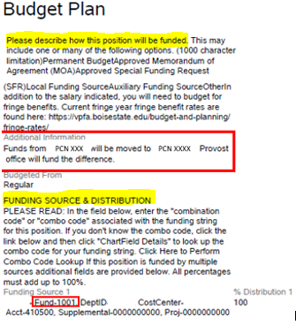
TALEO Requisition – Budget Plan
Good Example
This Budget Plan tells where the dollars will be moved from to pay the expenses of this employment action.
(Additional information might also include that PCN XXX would be deleted and a permanent budget transfer has been submitted. Any PMOA information could also be included here.)
The Funding Source & Distribution tell where the expense will be paid from.
Notes:
Kay
The Funding Source & Distribution show where the employee will be paid from.
The Budget Plan should tell where the Dollars are going to come from to pay the employee.
In this example the fund is an appropriated fund
The budget is moving from an existing PCN with any additional funding to be provided by the Provost.
Please provide any information that will explain what is happening and how it will affect the budget (dollars).
This is where OBP looks to see how the position is going to be paid for. Missing information requires OBP to contact
The department and delays the requisition’s progress.
Pretend you are explaining to someone from outside your area and doesn’t understand budgets.

Slide 20
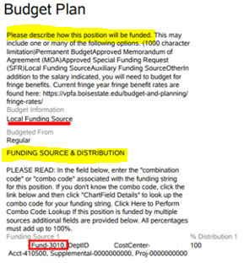
TALEO Requisition – Budget Plan
Poor Example
This Budget Plan and the Funding Source & Distribution tell the same information. The funding for this action will be paid from a local FDCC.
It doesn’t tell where the dollars will come from to support the salary expense.
Imagine that the funding source is your checking account. What is the source of the deposits? Wages, rebates, a check from your rich uncle?
The Budget Plan is to provide information regarding where the deposits are coming from.
Notes:
Kay
In this example the budget plan has the same information as the Funding Source.
This requisition would be held up. The Department would be emailed for additional information.

Slide 21
TALEO Requisition – Budget Plan
Local Fund Source Budget Plan Examples:
Local funds provided by revenue source (describe or name revenue activity)
Paid via reimbursement from Foundation funds, ######-Name of fund, for two years. Program growth will fund after two years. If program growth is not sufficient, College/VP will request funds on the FYXX Budget request
Local funds provided by fund balance transfer from (name of revenue cost center and how revenue is earned)
Notes:
Kay
Here are some examples of Budget Plan descriptions for Local Funding.

Slide 22
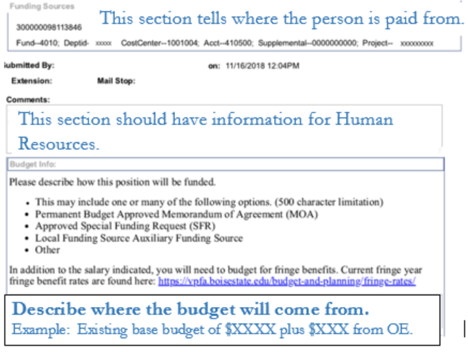
EAF Budget Information
Notes:
Kay
EAFs (Employee Action Forms) come through OBP for budget approval.
Funding Sources section
Provides information as to where the employee will be paid from.
Comments Section
Provide additional information for Human Resources
NEW!!! Budget Section
This is where the description of where the Budget (Dollars) will be moved to cover
the employee action related to the EAF. Some people have put the Budget Transfer’s
journal name here. VERY HELPFUL
Lack of information again causes a delay.
Tell the budget story as if you were explaining this to someone outside BSU.

Slide 23
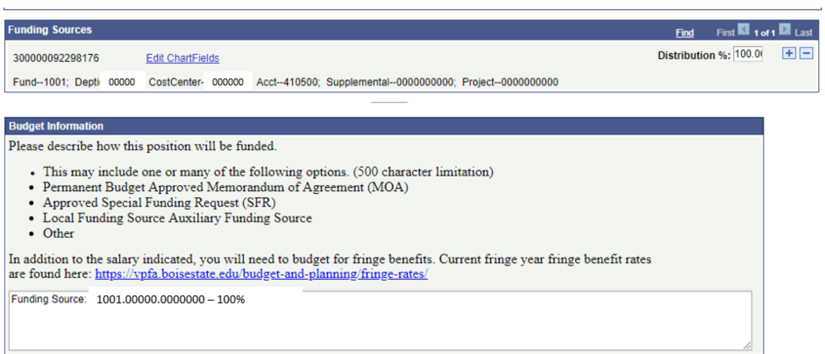
EAF Budget Information
In the example below, the Funding Sources Section and the Budget Information Section are providing the exact same information.
This does not provide where the “budget” is being moved to cover this salary expense.
Notes:
Kay
In this example the Funding Sources section and the Budget Information section are exactly the same.
It is telling where the employee will be paid from. Not where the budget to cover the employees pay
Is coming from.

Slide 24
EAF Budget Information
Examples of Good Budget Information:
PCN XXXX moving from cost center XXXXXXX to XXXXXXX Permanent transfer XXXXX MM.DD.YY XX 1 has been submitted to cover the additional expense.
Employee receiving merit increase. Additional budget will be moved from 1001.XXXXX.XXXXXXX OE to cover the additional expense. Permanent Budget transfer XXXXX MM.DD.YY XX 1 has been submitted.
Employee hired at more than budget, moving budget from Permanent Salary Savings to cover increase. Permanent Budget Transfer XXXXX MM.DD.YY XX 1.
Notes:
Kay
Examples of Budget Information OBP is looking for.

Slide 25
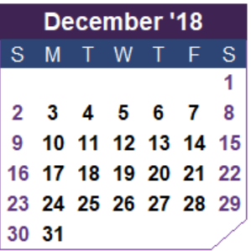
December – it’s not just the holidays
Time to Review
Appropriated Funding
Budget Request notices are sent to Deans and VPs and the budget request forms will be on our website
Departments should let their Business Managers know what their financial requirements will be for the next fiscal year
Notes:
Kay
December is the time to let your business manager or Dean know what your funding needs are for the next fiscal year.
Budget Request Notices are sent to Deans and VPs
This information goes to the Deans/VPs via Department Heads, etc. and then the Dean/VPs determine what will be requested.

Slide 26
How the Budget Request Flows
The Deans:
Review Requests
Prioritize
Send to Provost’s Office
The Provost:
Review Requests
Prioritize
Send to OBP
OBP organizes for President
The Vice Presidents:
Review Requests
Prioritize
Send to OBP
OBP organizes for President
The President:
Review Requests
Prioritizes
Determines What to Fund
From Central
Notes:
Kay
The Office of Budget and Planning does not make decisions regarding funding.
OBP Collects the information
Compiles the information for review
Provides this information to the President.
The President determines what funding requests are most needed to advance the
Universities’ Mission.

Slide 27
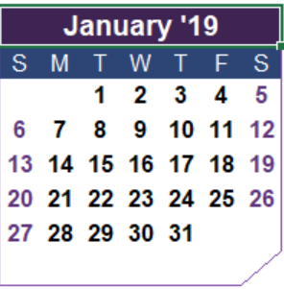
What happens in January?
The Governor will speak about budget initiatives in the State of the State Address.
The Governor’s budget recommendation goes to the Legislature the State of the State Address.
What will funding will be approved will be announced in March or April
Continue to monitor budgets to ensure that they are not in deficit.
Notes:
Kay
In January, the Governor gives his State of the State Address
The Governer’s budget initiatives are sent to the Legislature after the address
Governer’s budget suggestion is posted on the web
The Legislature determines what and how much
Can see what the Governer’s budget request is for higher ed but the legislature will determine the actual amount
The University is trying to put together the budget for the next fiscal year using information that is uncertain

Slide 28
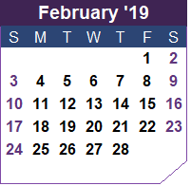
February is…
Time to work on employee evaluations for the Human Resources deadline of March 1, 2019
Student Fee Hearings begin
Budget Requests from departments due to the Office of Budget and Planning
Continue to monitor budgets to ensure that they are not in deficit.
Notes:
Kay
Employee evaluations for Human Resources deadline is March 1st
Evaluations feed into the CEC (Change in Employee Compensation) process.
Note: If position has base appropriated funding Central covers the increase.
If any part of position budget is unfunded-the department covers the increase.
Includes increase in CEC and fringe benefits on the unfunded portion.
Student Fee Hearings take place in February which determine where part of student tuition is spent.
Budget Requests are due to be returned to the Office of Budget and Planning.

Slide 29
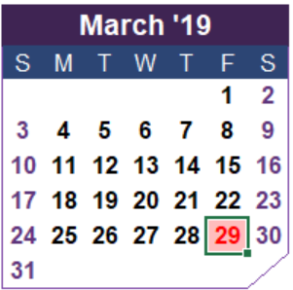
March is here…hold on to your hats!
The State Legislature passes the appropriated budget in March
March 29, 2019 Last day for OBP to receive the following:
EAF/TALEO hiring actions must be approved to ensure it will be reflected in the FY20 Budget Book
FY19 Permanent Budget Transfers
EAF/TALEO hiring actions received by the Office of Budget and Planning after this date may or may not be reflected in the FY20 Budget Book
FY20 Budget Transfers should not be submitted until July 1, 2019
Notes:
Kay
March is one of the busiest months in the Office of Budget and Planning.
DEADLINES-----MARCH 29, 2019 For changes to show in the FY20 Budget Book
Last day to submit FY19 Permanent Budget Transfers
Last day for OBP to receive EAF/TALEO hiring actions
Employee actions (EAFs/TALEO) will still be received and processed after March 29
Just not guaranteed to be reflected in the FY20 Budget Book

Slide 30
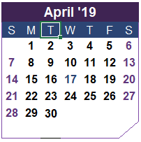
And April arrives…
Activities that affect your budgets
● The State Board of Education meets to set the 2019-2020 Tuition rates
● FY20 Reallocation Schedules are sent to the Deans and VP Offices for review (To adjust budgets to accommodate College/Division initiatives)
Budget Requests that were submitted in December are prioritized and approved by the President and anything approved will be funded after July 1st
Notes:
Kay
Reallocation Spreadsheets go out to Campus.
If your department’s base budget needs to change, complete this form.
(Cannot move position budget on this form)
These changes will be reflected in OFC’s original budget load.

Slide 31
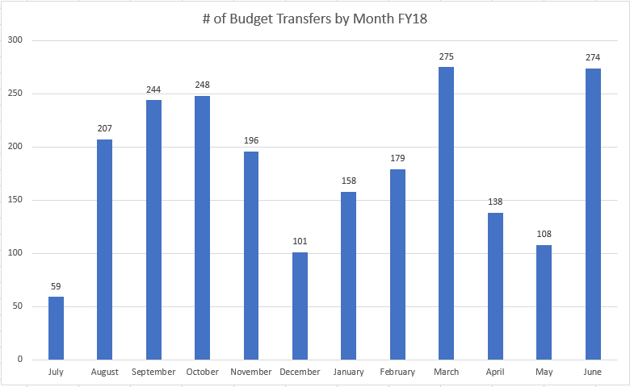
347
& FY19
244
259
177
FY 18
FY 19
Notes:
Kay
A large number of budget transfers throughout the year
Determine if there needs to be an adjustment
This can be accomplished on the Reallocation Sheets
Combine transfers when possible
Transfers can still be submitted and to move budget when necessary.
Example: Funding a new position or other salary increases

Slide 32
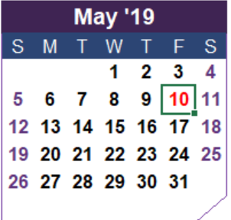
Along comes May…let’s wrap things up
The Office of Budget and Planning is responsible for submitting Boise State’s proposed budget to the State Board of Education. This year’s due date for submission to the State of Idaho is May 10, 2019.
Contracts
The Office of Budget and Planning prints FY20 employment contracts for Professional Staff and Faculty at Boise State
Contracts are distributed to Business Managers/ Dean’s Office after the middle of May and in turn are distributed to employees for signature and generally returned to these offices before the originals are forwarded to Human Resources
Notes:
Kay
The Office of Budget and Planning is responsible for submitting the University’s Budget to the State Board Of Education. Remember earlier when it was mentioned that the Legislature announces the budget sometime in March/April. The budget request to SBOE is due May 10. Lots of fine tuning going on here. This is when the President knows how much additional budget will be available.
Contracts Professional Staff and Faculty are issued.
Contracts are delivered business manager who in turns sends them to the employee for signature, then collects and sends them to HR.

Slide 33
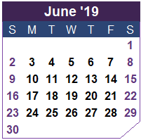
June rolls around again…
gear up for the new fiscal year!
The Office of Budget and Planning works to get all approved funding in place to upload the Boise State budget into OFC
Late June
FY20 Appropriated, Local, & Auxiliary budgets are loaded into OFC
FY20 Appropriated, Local & Auxiliary Budget Books are available on the Office of Budget and Planning website
Notes:
Kay
June is the fiscal year end
The Office of Budget and Planning is
Finalizing budgets for upload into OFC
Wrapping up any outstanding items/activities
Budget Office working on updating the Budget Desk Manual we hope to have this available on our web site. If you are a BSU_Budget group member, you will receive a notice when this happens. If you are not a member of the group, please email budgetandplanning@boisestate.edu and request to be added.
Turn over to Stephanie

Slide 34
REPORTS
How do I find my transactions??
Notes:
Stephanie

Slide 35
Budget Vs. Actuals Reports
OFC Dashboard Report
Budget Vs. Actual Pivot
Hierarchies/Naming Convention
Month End reports from Budget &Planning
Chart of Accounts Maintenance (update coming)
Workflow Approval for Budget Transfers
Standard Workflow Approval
What do you use/need
Coming Soon
Budget Vs Actuals Data Warehouse Report
Smartsheet Budget Transfer Tracking via SmartSheets
Notes:
Stephanie
-Show Dashboard Reports talk about wildcards
B v A pivot- have an example ready. Show them the hierarchy/ Talk about naming
Show example of Reports I send out. Level I send to.
Show where to find COA maint form currently is- moving to Smart Sheets soon.
Approvals- talk about how ours work
What do they use/need
Coming- DW report
Transfer Tracking

Slide 36
Q & A
Notes:
All

